Slide 1
COMPUTER ARCHITECTURE & ORGANIZATION
Notes:
Manav Rachna College of Engineering

Slide 2
Addressing Modes

Slide 3
Addressing Modes
In simple words we can say the addressing mode is the way to fetch operands (or Data) from memory during execution.
Specifies a rule for interpreting or modifying the address field of the instruction (before the operand is actually referenced).
Variety of addressing modes
- To give programming versatility to the user
- To reduce the number of bits in the addressing field of the instruction

Slide 4
Operation Cycle of Computer
Fetch the instruction from memory
Decode the instruction
Execute the instruction
Program Counter (PC) register keeps track of the instructions in the program stored in memory. Hold address of instruction to be executed next and is incremented each time an inst. Is fetched from memory.

Slide 5
TYPES OF ADDRESSING MODES
Implied Mode
Immediate Mode
Register Mode
Register Indirect Mode
Autoincrement & Autodecrement Mode
Direct address Mode
Indirect address Mode
Relative Address Mode
Indexed Addressing Mode
Base Register Addressing Mode

Slide 6
TYPES OF ADDRESSING MODES
Implied Mode: Address of the operands are specified implicitly in the definition of the instruction
- No need to specify address in the instruction
- Examples- “Complement accumulator” or all zero address in the stack-organized computer.

Slide 7
Immediate Mode: Instead of specifying the address of the operand, operand itself is specified in the instruction.
- No need to specify address in the instruction
- This mode has an operand field rather than an address field.
Useful for initializing registers to a constant value.
Disadvantage: Sometimes, require more bits than the address
Advantage: fast to acquire an operand

Slide 8
Register Mode: Address specified in the instruction is the register address
Designated operand need to be in a register.
A k-bit field can specify any one of 2^{k} registers.
Advantages:
(i) Shorter address than the memory address.
(ii) Saving address fields in the instruction.
(iii) Faster to acquire an operand than the memory addressing.

Slide 9
Register Indirect Mode: Instruction specifies a register which contains the memory address of the operand.
- Advantage: Saving instruction bits since register address is shorter than the memory address.
- Disadvantage: Slower to acquire an operand than both the register addressing and memory addressing.

Slide 10
Auto increment or Auto decrement Mode: Similar to the register indirect mode except
-The address in the register is incremented or decremented after (or before) its value is used to access memory.
-The value in the register is incremented or decremented by 1 automatically.
- Used to refer table of data in memory.
-In Auto increment mode, the increment is done after execution of instruction takes place.
-In Auto decrement mode, the decrement is done before the execution of instruction.

Slide 11
Sometimes the value given in the address field is the address of the operand, but sometimes it is just an address from which the address of the operand is calculated.
Effective address: is defined to be the memory address obtained from the computation dictated by the given addressing mode.
Effective address = address part of instruction + content of CPU register

Slide 12
Direct Address Mode: Instruction specifies the memory address which can be used directly to access the memory
- Advantage: Faster than the other memory addressing modes
- Disadvantage: Too many bits are needed to specify the address for a large physical memory space
- E.g.: the address field in a branch-type instruction
Indirect Addressing Mode : The address field of an instruction specifies the address of a memory location that contains the address of the operand.
- Disadvantage: Slow to acquire an operand because of an additional memory access.

Slide 13
Relative Addressing Mode: In this mode the content of the program counter is added to the address part of the instruction in order to obtain the effective address.
Indexed Addressing Mode: In this mode the content of the index register is added to the address part of the instruction in order to obtain the effective address.
Base Register Addressing Mode: In this mode the content of the base register is added to the address part of the instruction in order to obtain the effective address.

Slide 14
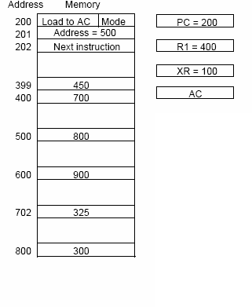

Slide 15
